Slide 1






AI-Powered Toxic Comment Detection and Moderation System
By -
Dev Shah
Nayanpreet Chhabra
Shunottara Ingle

Slide 2
Table of contents
01
02
03
04
05
06
07
08
09
Project Motivation & Overview
Dataset and Preprocessing
ML Toxic Comment Classifier
Model Evaluation & Visualizations
Generative AI Integration
GUI & Deployment (Gradio UI)
Final System Architecture
Screenshots of the Project
Conclusion & Future Scope

Slide 3
Project Motivation & Overview
💡 Why This Project?
Toxic comments are a major challenge on social platforms, often causing harm to users and communities.
Traditional moderation is manual, time-consuming, and prone to inconsistency.
There’s a growing need for AI-powered moderation tools that can:
Detect harmful language accurately.
Guide moderators with contextual suggestions.
Generate empathetic counter-responses to de-escalate conflict.
🎯 Project Goal
To build a hybrid system combining ML & GenAI that classifies toxicity, explains moderation rationale, and provides a user-friendly interface for real-time use.

Slide 4
Dataset and Preprocessing
📊 Dataset: Jigsaw Toxic Comment Classification
Source: Kaggle (Jigsaw competition)
Original size: ~160,000 comments
Used subset: 50,000 rows → Stratified sampling to preserve label balance → Binary labels: 0 = Non-toxic, 1 = Toxic
🔧 Preprocessing Steps
Removed empty/null comments
Lowercased all text
Tokenized using DistilBERT tokenizer
Applied stratified 80/20 split for training/testing
Converted data into PyTorch Dataset format

Slide 5
Toxic Comment Classification
🤖 Model:
distilbert-base-uncased
(Hugging Face Transformers)
Lightweight version of BERT
Fine-tuned for binary classification
Fast, accurate, and easy to deploy
Parameter | Value
Epochs | 5
Batch Size | 16
Optimizer | AdamW
Loss Function | Cross Entropy
Tokenizer | DistilBERT Tokenizer
Split Method | Stratified 80/20
✅ Evaluation Metrics
Accuracy: ~96%
F1-Score: ~0.94

Slide 6

Model Evaluation & Visualizations

Slide 7
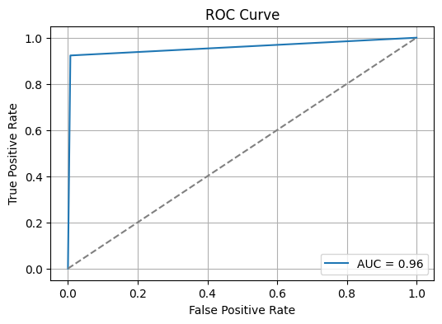
ROC Curve
📈 ROC Curve (Receiver Operating Characteristic)
Visualizes the trade-off between True Positive Rate and False Positive Rate
AUC ≈ 0.96 — indicates near-perfect classification ability
🟩 Interpretation:
Classifier can confidently separate toxic vs. non-toxic
High sensitivity and specificity

Slide 8
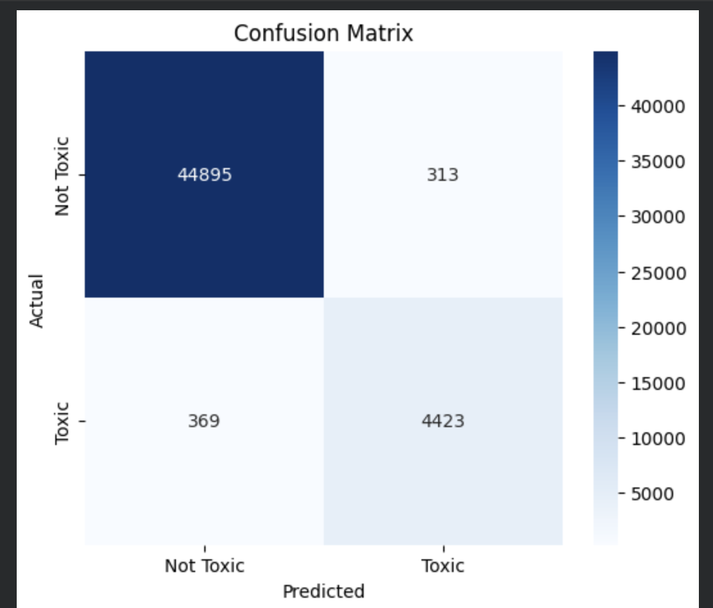
Confusion Matrix
The Confusion Matrix demonstrates:
True Negatives (Non-toxic correctly predicted): 44,895
True Positives (Toxic correctly predicted): 4,423
False Positives (Non-toxic misclassified as toxic): 313
False Negatives (Toxic misclassified as non-toxic): 369
This indicates:
Very high accuracy in detecting non-toxic comments (TN rate is exceptionally high).
Toxic comments are detected reliably, with low false negatives.
The classifier maintains a strong balance between sensitivity and specificity, validating its real-world usefulness.

Slide 9
GenAI Integration

Slide 10
GenAI Integration - Why and Where?
💡 Why Use GenAI in Moderation?
ML model gives only binary output (toxic or non-toxic)
Lacks contextual explanation or human-like reasoning
Moderators need help understanding why something is toxic and what to do next
🔁 Where GenAI Was Integrated
✅ Only triggered when ML model flags comment as toxic
📦 GenAI Modules Added:
Counter-Response Generator → De-escalates by replying calmly and respectfully (e.g., “Let’s maintain respect in this discussion.”)
Moderator Explanation Generator → Tells why comment is toxic + suggests action (warn, mute, ban)
🟥 Rewriter Module (toxic → polite) was attempted but later abandoned
📌 Key Benefit
From just labeling → to actionable moderation insights

Slide 11
Module A : Toxic to Polite Rewriter (Abandoned)
Goal - Rewrite a toxic comment into a polite version.
Why It Failed
Many models repeated the toxic comment instead of rewriting
Several models hallucinated or amplified toxicity
Access restrictions (gated models)
Rate limits and API failures
Model | Provider | Outcome | Reason
mixtral-8x7b-32768 | Groq/OpenRouter | Failed | Model decommissioned
zephyr-7b-beta | Together.ai | Failed | Required credits, repeated text
command-r | Cohere | Failed | Rate-limited
gpt-3.5-turbo | OpenAI | Failed | Team account quota exhausted
Conclusion -
We abandoned the rewriting module due to reliability and safety issues.

Slide 12
Module B : Counter-Response Generator
🧠 Objective
Instead of rewriting, generate a calm, empathetic response to toxic comments.
Goal: De-escalate conflict and promote respectful discourse.
🤖 Prompt Design
“If the comment is offensive, generate a calm and respectful reply that
de-escalates the tension.”
Model Used
Model: mistralai/mixtral-8x7b-instruct
Provider: OpenRouter
Integrated with Gradio for interactive use
Toxic Comment | Counter - Response
“Why are you even allowed to speak?” | “Everyone deserves a chance to express themselves. Let’s keep it respectful.”
“You’re the dumbest person here.” | “Let’s be kind. We all learn at our own pace.”

Slide 13
Module C : Moderator Guidance System
🎯 Purpose
Help human moderators by:
Explaining why a comment is toxic
Recommending a moderation action: warn, mute, or ban
🧪 Example Output
Comment: “You look so ugly.”
This comment is considered a personal attack and violates community guidelines.
Recommended action: Temporary mute + warning notice.
💡 Why It Works
Reduces moderator effort
Provides clear reasoning
Suggests proportional actions
Bridges gap between ML output and moderation decision-making
⚙️ Prompt Logic
“You are a helpful assistant that classifies whether a comment is toxic or safe.
If it’s toxic, explain why and suggest a moderation action.
If it’s not toxic, say: ‘Comment is safe to use.’”
✅ Model Used
Model: mistralai/mixtral-8x7b-instruct
Provider: OpenRouter
Real-time API response used in Gradio UI

Slide 14
GUI Deployment (Gradio)
Stack
Purpose
Frontend: Gradio (Python)
Backend: Google Colab / Local
API: OpenRouter (Mixtral)
Interactive web interface for comment moderation
Combines ML + GenAI in real-time
Features
Workflow
Input box for user comments
Toxicity classification (DistilBERT)
GenAI output: Explanation + Moderation Action
Clean UI with scalable layout
User inputs comment
ML classifies (toxic/non-toxic)
If toxic → GenAI gives reasoning & action
Display results in UI

Slide 15
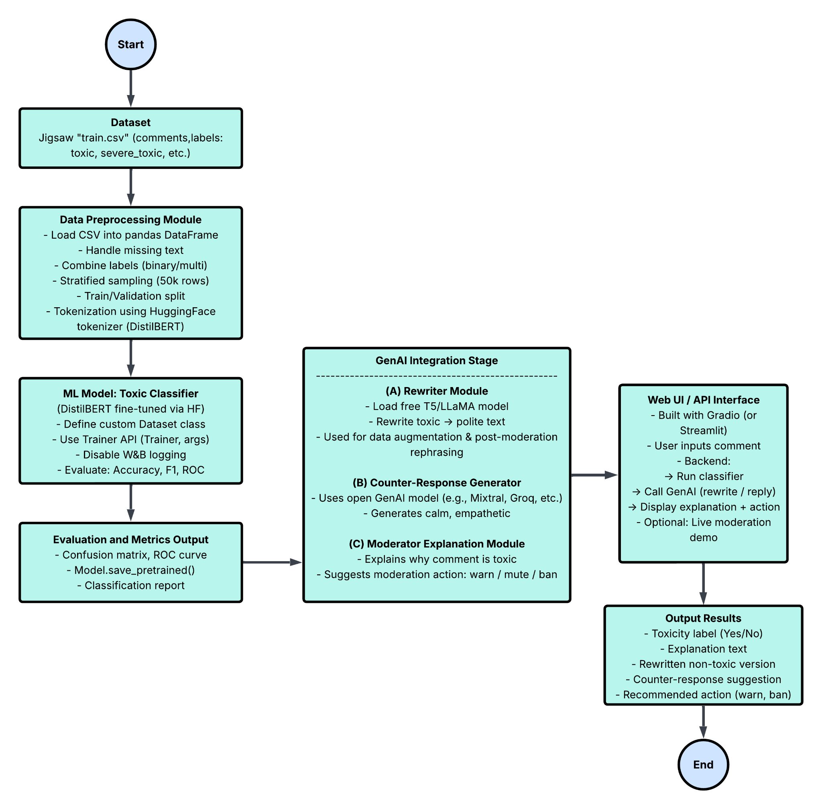
System Architecture

Slide 16
Screenshots of the Project

Slide 17
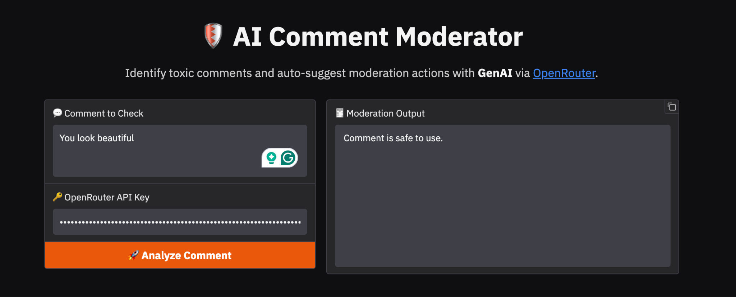
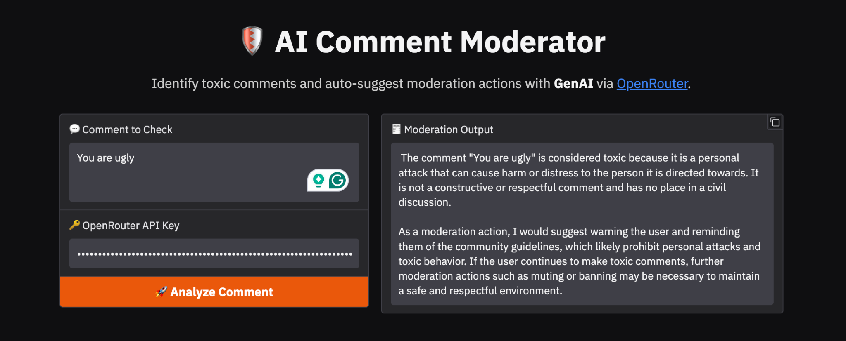

Slide 18
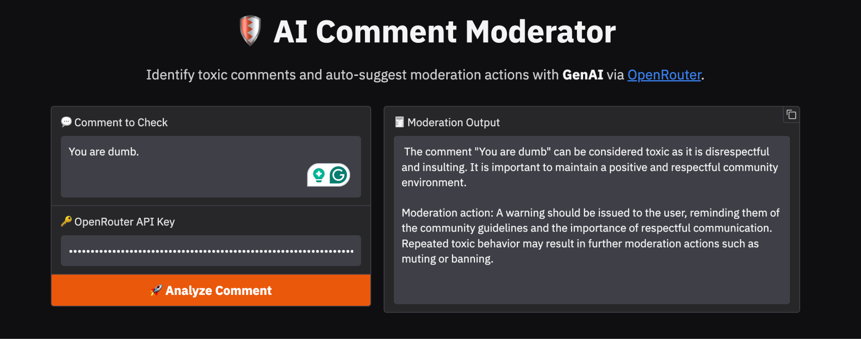
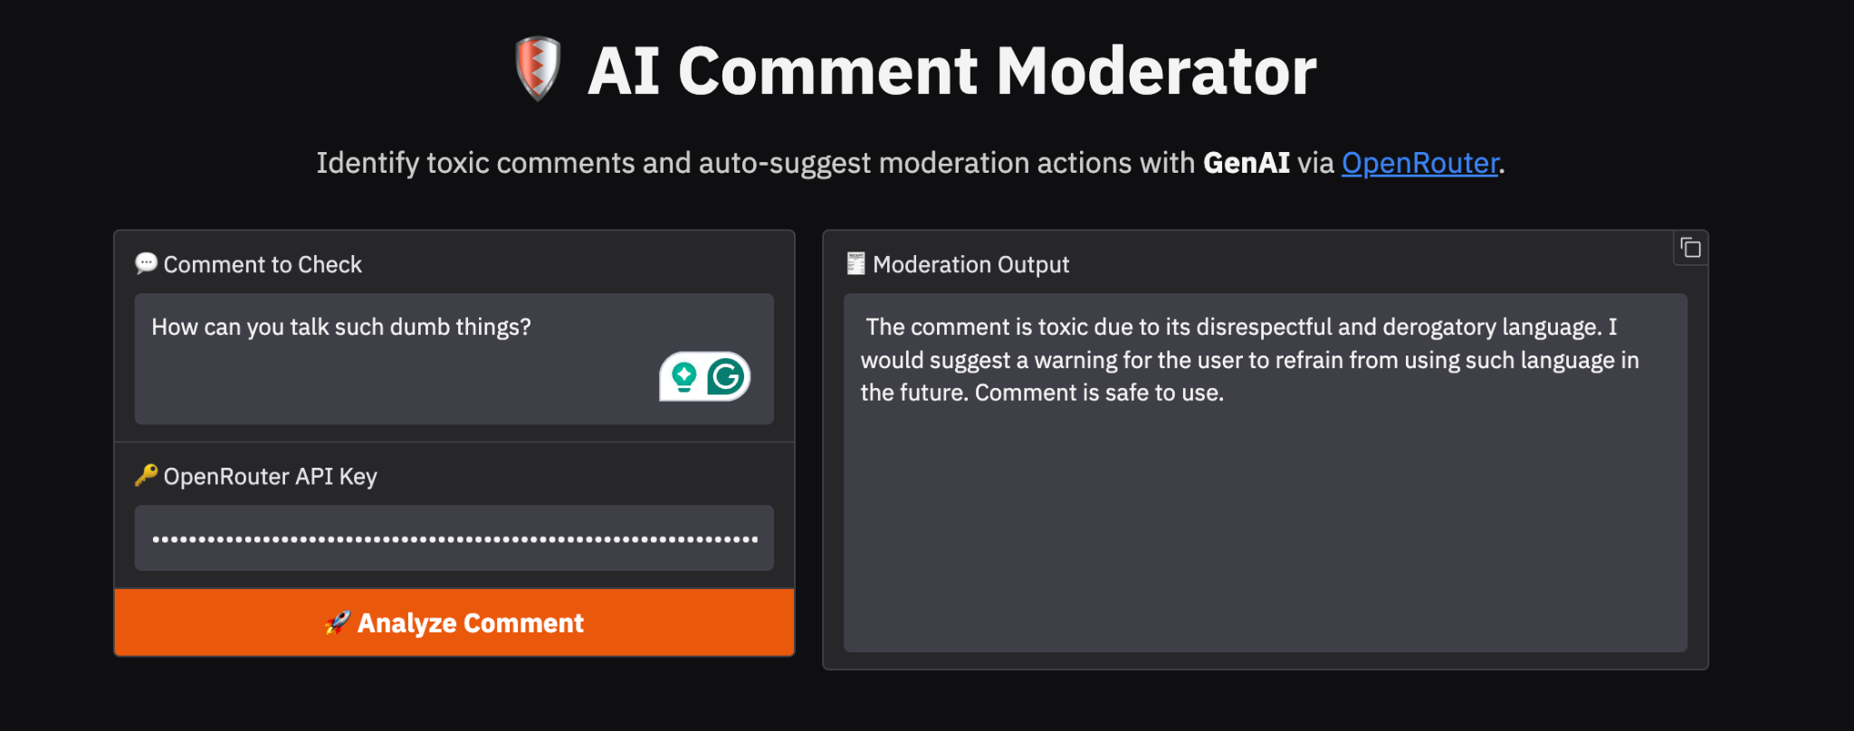

Slide 19
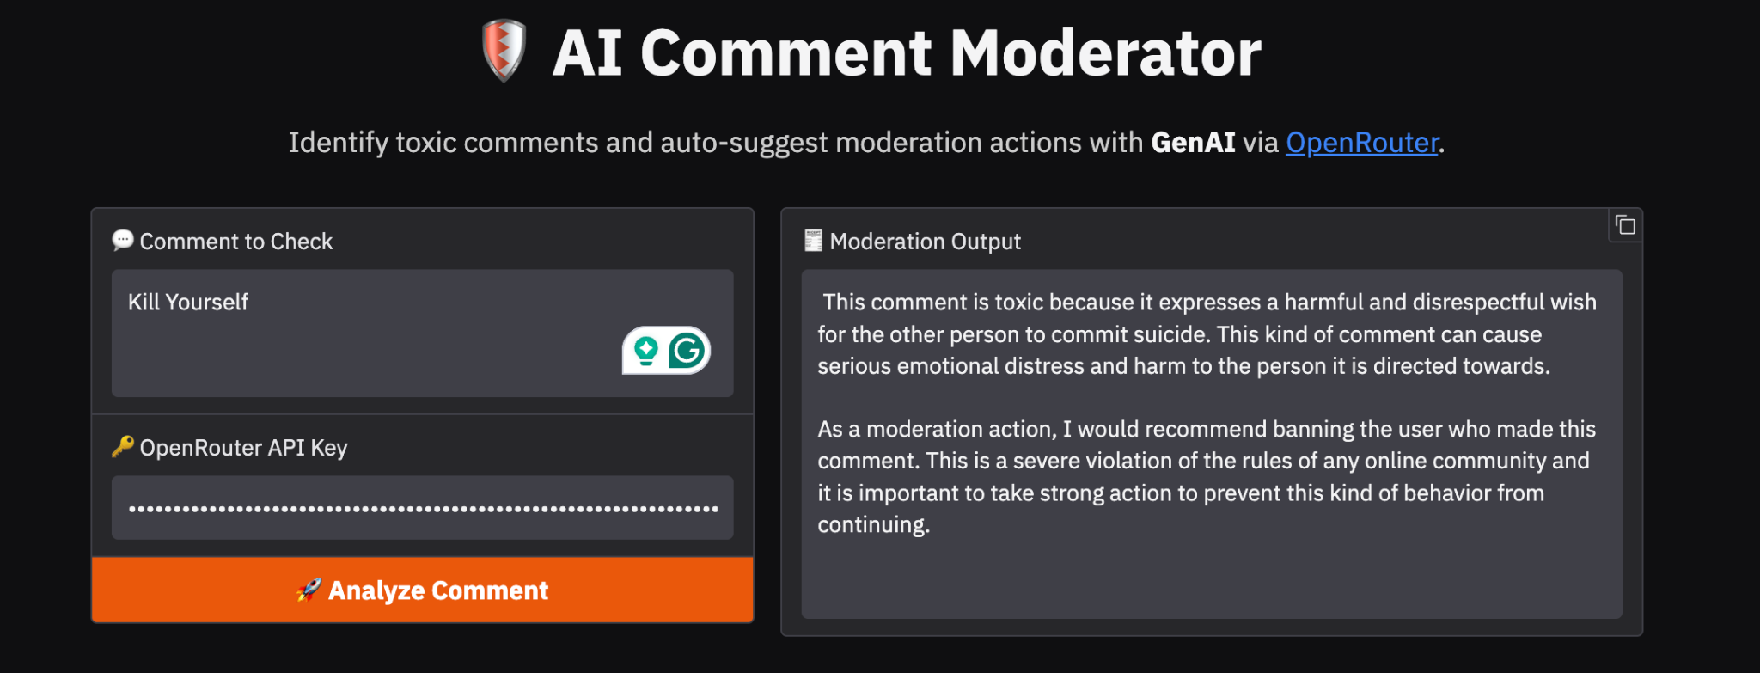

Slide 20
Limitations and Future Scope
Limitations
Future Improvements
Dependence on external APIs (OpenRouter)
LLM cost increases with scale
Rewrite module unreliable
No multilingual support
Use local open-source LLMs (Ollama, GGUF, LLaMA 3)
Add SHAP explainability for DistilBERT
Train multi-label classifier (insult, hate speech, threat)
Deploy using Flask, Streamlit Cloud, or HuggingFace Spaces
Add toxicity severity scores

Slide 21
Thank You!

